Slide 1

PROJECT
U.S. FDA DATA ANALYSIS
Name – Shishir kherod
Email – kherodshishir@gmail.com
Course – ABADS
Batch – Batch 11

Slide 2

Business Objective
To create informative reports by conducting a thorough analysis of the FDA’s data using powerful tools like MySQL and Power BI.

Slide 3

Part - 1 SQL Queries:
Task 1: Identifying Approval Trends
Determine the number of drugs approved each year and provide insights into the yearly trends.
SELECT YEAR(ActionDate) AS approval_year, COUNT(*) AS num_drugs_approved
FROM regactiondate
GROUP BY approval_year
ORDER BY approval_year;
2. Identify the top three years that got the highest and lowest approvals, in descending and ascending order,
respectively.
SELECT YEAR(ActionDate) AS approval_year, COUNT(*) AS num_drugs_approved
FROM regactiondate
GROUP BY approval_year
ORDER BY num_drugs_approved DESC
LIMIT 3;
SELECT YEAR(ActionDate) AS approval_year, COUNT(*) AS num_drugs_approved
FROM regactiondate
GROUP BY approval_year
ORDER BY num_drugs_approved ASC
LIMIT 3;
3.Explore approval trends over the years based on sponsors.
SELECT YEAR(ActionDate) AS approval_year, SponsorApplicant, COUNT(*) AS num_drugs_approved
FROM regactiondate ra
JOIN application ap ON ra.ApplNo = ap.ApplNo
GROUP BY approval_year, ap.SponsorApplicant
ORDER BY approval_year, num_drugs_approved DESC;

Slide 4
4. Rank sponsors based on the total number of approvals they received each year between 1939 and 1960.
SELECT YEAR(ActionDate) AS approval_year, SponsorApplicant, COUNT(*) AS num_drugs_approved
FROM regactiondate ra
JOIN application ap ON ra.ApplNo = ap.ApplNo
WHERE ra.ActionDate BETWEEN '1939-01-01' AND '1960-12-31‘
GROUP BY approval_year, ap.SponsorApplicant
ORDER BY approval_year, num_drugs_approved DESC;
Task 2: Segmentation Analysis Based on Drug MarketingStatus
1.Group products based on MarketingStatus. Provide meaningful insights into the segmentation patterns.
SELECT ProductMktStatus, COUNT(*) AS num_products
FROM product
GROUP BY ProductMktStatus;
2. Calculate the total number of applications for each MarketingStatus year-wise after the year 2010.
SELECT YEAR(ActionDate) AS application_year, ProductMktStatus, COUNT(*) AS num_applications
FROM regactiondate ra
JOIN product p ON ra.ApplNo = p.ApplNo
WHERE YEAR(ActionDate) > 2010
GROUP BY application_year, ProductMktStatus
ORDER BY application_year, num_applications DESC;

Slide 5
3. Identify the top MarketingStatus with the maximum number of applications and analyse its trend over time.
SELECT ProductMktStatus, YEAR(ActionDate) AS application_year, COUNT(*) AS num_applications
FROM regactiondate ra
JOIN product p ON ra.ApplNo = p.ApplNo
GROUP BY ProductMktStatus, application_year
ORDER BY num_applications DESC
LIMIT 5;
Task 3: Analysing Products
Categorize Products by dosage form and analyse their distribution.
SELECT Dosage, COUNT(*) AS num_products
FROM product
GROUP BY Dosage
ORDER BY num_products DESC;
2. Calculate the total number of approvals for each dosage form and identify the most successful forms.
SELECT Dosage, COUNT(*) AS num_approvals
FROM product p
JOIN application a ON p.ApplNo = a.ApplNo
WHERE a.ActionType = 'AP‘
GROUP BY Dosage
ORDER BY num_approvals DESC;

Slide 6
3. Investigate yearly trends related to successful forms.
SELECT YEAR(ActionDate) AS approval_year, Dosage, COUNT(*) AS num_approvals
FROM regactiondate ra
JOIN product p ON ra.ApplNo = p.ApplNo
WHERE ra.ActionType = 'AP‘
GROUP BY approval_year, Dosage
ORDER BY approval_year, num_approvals DESC;
Task 4: Exploring Therapeutic Classes and Approval Trends
Analyse drug approvals based on therapeutic evaluation code (TE_Code).
SELECT TECode, COUNT(*) AS num_approvals
FROM product_tecode pte
JOIN regactiondate ra ON pte.ApplNo = ra.ApplNo
WHERE ActionType = 'AP‘
GROUP BY TECode
ORDER BY num_approvals DESC;
2. Determine the therapeutic evaluation code (TE_Code) with the highest number of Approvals in each year.
SELECT YEAR(ActionDate) AS approval_year, TECode, COUNT(*) AS num_approvals
FROM regactiondate ra
JOIN product_tecode pte ON ra.ApplNo = pte.ApplNo
WHERE ActionType = 'AP‘
GROUP BY approval_year, TECode
ORDER BY approval_year, num_approvals DESC;

Slide 7
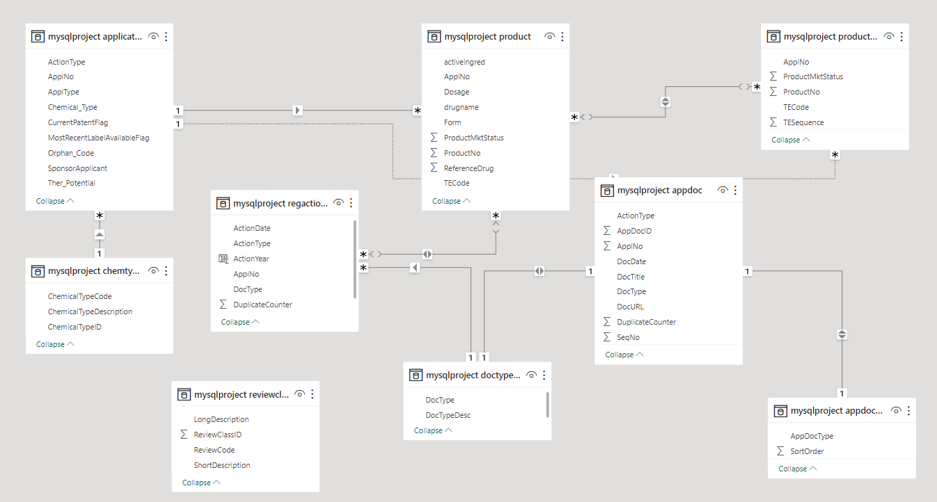
Power BI Model View

Slide 8

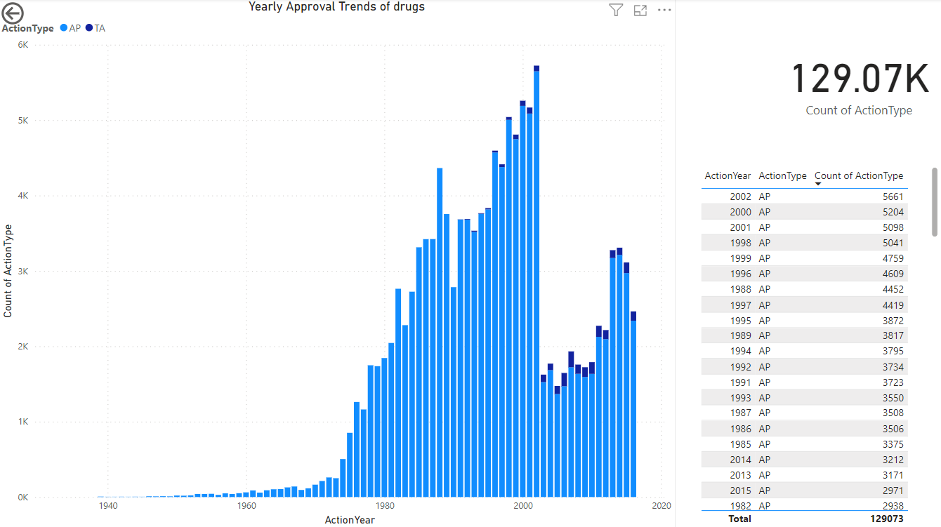
Part - 2 Power BI Visualizations:
1. Visualize the yearly approval trends of drugs. Highlight any significant patterns and/or fluctuations, if any.
As per the Statistics, the approved drugs are highest in the year 2002 i.e. 5661.
The total count of Drugs is 129.07K
From year 1939 to 2016 which includes Both AP and TA ( Tentative Drugs).

Slide 9
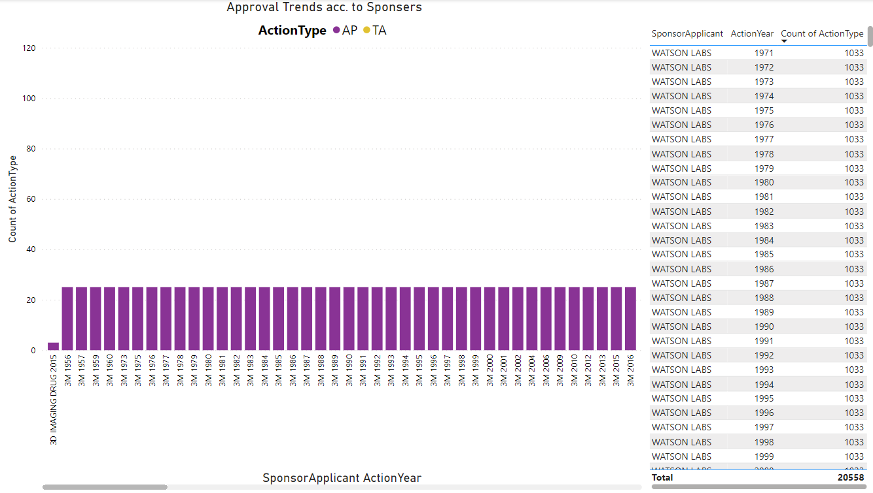

2. Explore approval trends over the years based on different sponsors. Uncover patterns and changes in approval rates among sponsors.
According to this visualization, the most reliable and having the highest approvals over many years is WATSON LABS which gives the consistent of 1033 approvals each year followed by another sponsor SANDOZ having 636 approval each year.

Slide 10
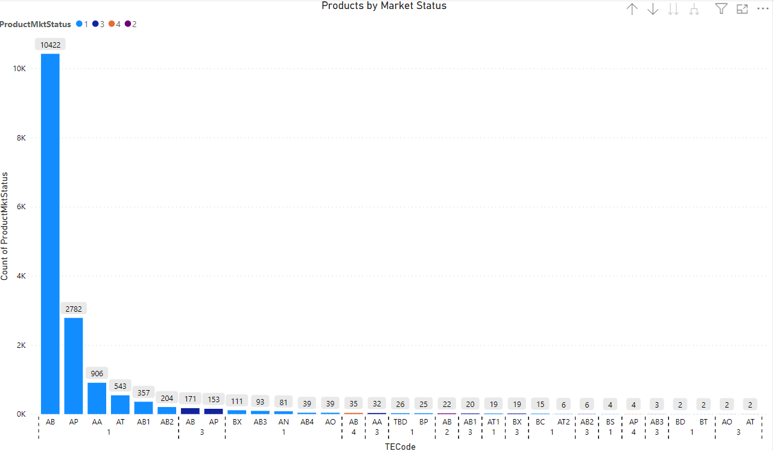
3. Visualize the segmentation of products based on MarketingStatus.
RIMBERIO
The visualization shows us the different pharmaceutically equivalent products as per the Market Status.
Here the product type AB (10422) and AP(2782) have the highest numbers in Market status 1.
AB are Drug products for which actual or potential bioequivalence problems have been resolved with adequate in vivo and/or in vitro evidence supporting bioequivalence.
AP are products whose therapeutically equivalent rating is assigned as they are manufactured in accordance with Current Good Manufacturing Practice regulations and meet the other requirements of their approved applications

Slide 11
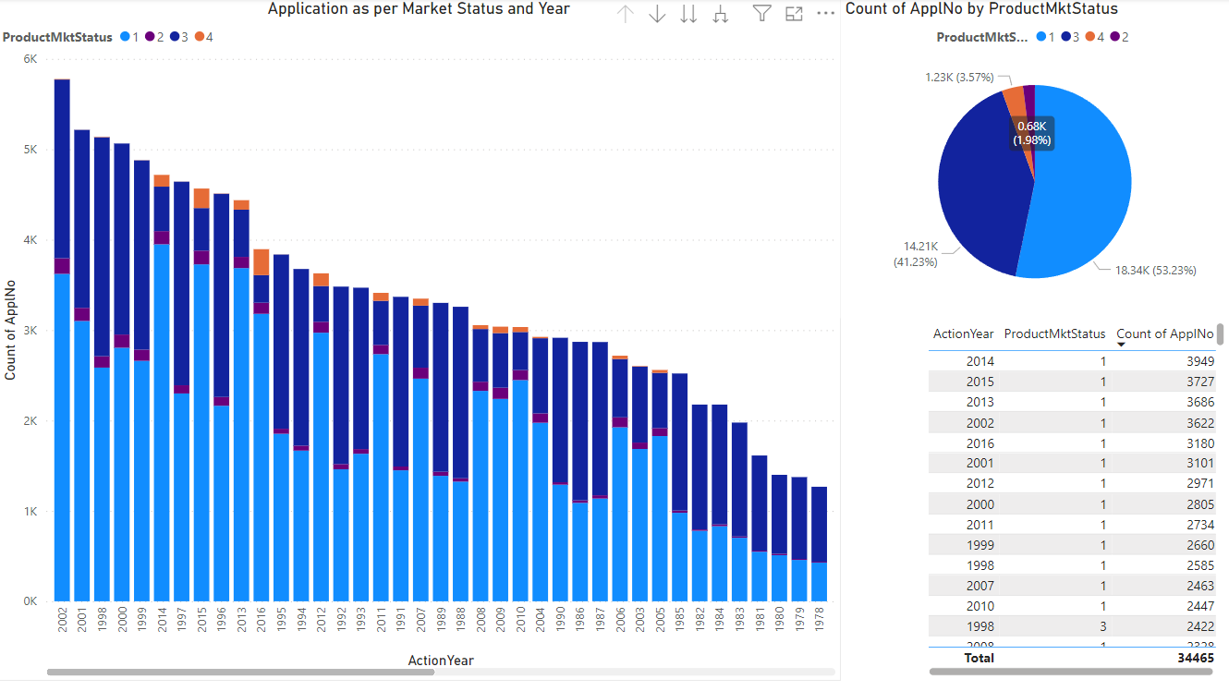
4. Show the total number of applications for each MarketingStatus. Enable users to filter by years and MarketingStatus for detailed analysis.
These visuals shows the number of applications for each Market status and Year.
As per the chart, year 2002 has the maximum no. of overall applications i.e. 5778 while year 2014 has the most applications in Market Status 1 i.e. 3949.

Slide 12

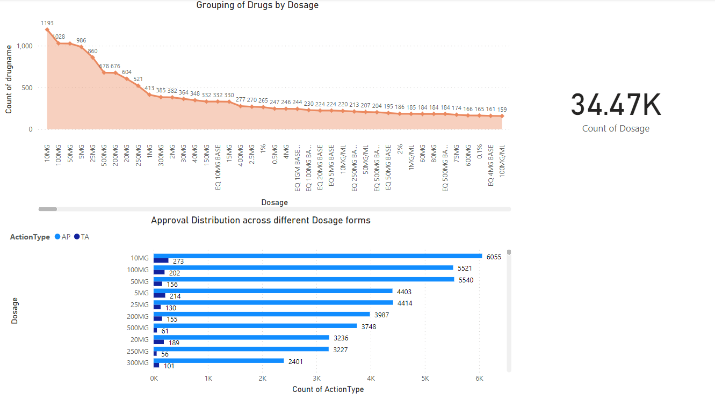
5. Analyse the grouping of drugs by dosage form. Visualize the distribution of approvals across different forms. Identify the most successful dosage form.
After analyzation it shows that 10MG Dosage form has the maximum types of Drugs i.e. 1193 followed by 100MG Dosage form with 1028 Drug types. So these two forms have the most use for customers depends on the needs.
As per the Bar chart, the
maximum approval are given
to the 10MG Dosage form in
both AP i.e. 6055 and in TA
i.e. 273. The low dosage like
10MG and 50 MG are most
successful as maximum variety
of medicines are made and
even for small medical needs.

Slide 13
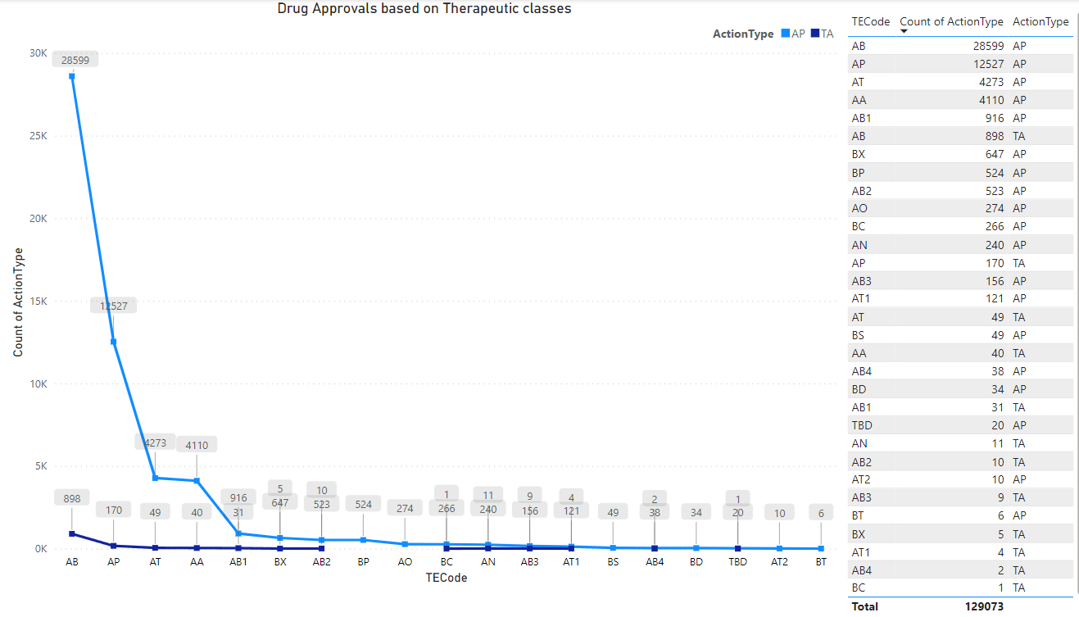
6. Visualize drug approvals based on therapeutic classes. Identify classes with the highest number of approvals.
Based on the therapeutic classes
Drugs type AB has the highest number of approval rate i.e. 28599 followed by the Drug type AP with approvals of 12527.

Slide 14

hello@reallygreatsite.com
www.reallygreatsite.com
Thank you
www.reallygreatsite.com

